Slide 1



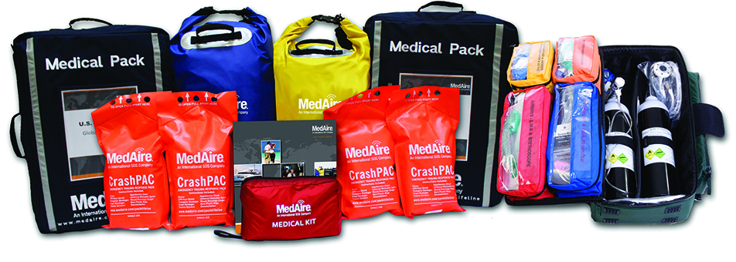


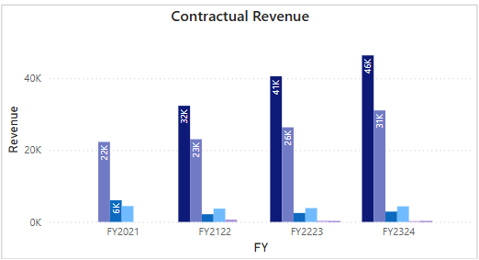
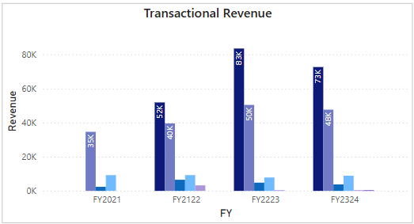
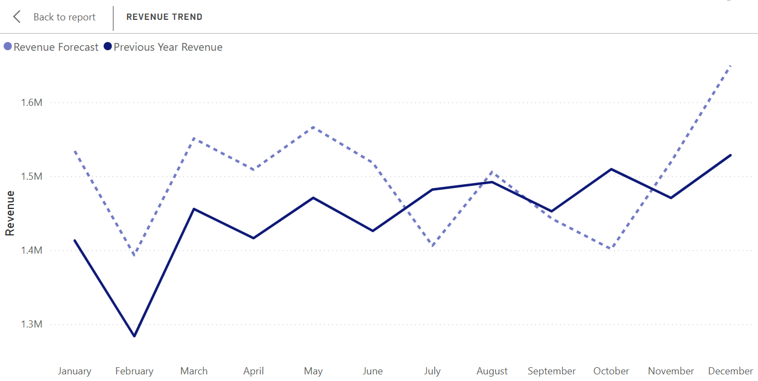

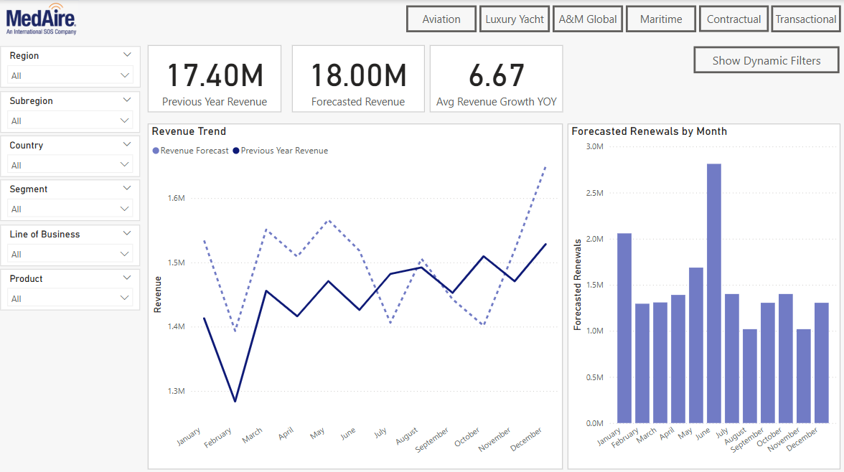


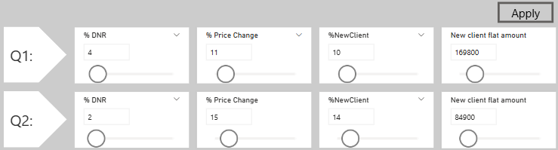





REPLACE THIS BOX WITH YOUR ORGANIZATION’S
HIGH RESOLUTION LOGO
MedAire Inc. Rolling Full Revenue Forecast Model
W.P. Carey School of Business: Master of Science in Business Analytics (MS-BA)
PARTNER COMPANY: MEDAIRE INC.
DATA INSIGHTS
KEY TAKEAWAYS
MedAire Inc. is a global provider of medical and travel safety services for the aviation and maritime industries. Founded in 1985 and headquartered in Phoenix, Arizona, it operates as a subsidiary of International SOS.
What They Do:
Deliver 24/7 remote medical and security support
Provide telemedicine, medical kits, and crew training
Project Relevance:
Financial forecasting of medical service demand and cost
Data analytics to identify high-risk regions & cost drivers
Supports budget planning, efficiency, and risk mitigation
The forecasting model was built using Invoiced Sales Data and Outlook EBIT files to estimate both contractual and transactional revenues. Data was cleaned and transformed using Excel and Python to prepare it for accurate forecasting and Power BI integration.
Transformations included standardizing dates, aligning revenue categories, and aggregating monthly values for time-based analysis. The structured datasets were optimized for use in Power BI to enable interactive forecasting and scenario modeling.
The integrated rolling forecast model combined contractual and transactional revenues, producing dynamic, month-by-month revenue projections.
The model revealed seasonal trends and year-over-year growth, with transactional revenue showing higher variability due to pricing, market shifts, and new business activity.
Power BI dashboards allowed users to drill into results by region, market, and product line, offering transparency into levers like renewals, DNR rates, pricing, and new client onboarding.
Scenario testing showed that small changes (e.g., +5% renewals or launching a new product) significantly impacted forecasts at both regional and enterprise levels.
The forecast closely aligned with historical actuals and surfaced the timing effects on deferred revenue, especially when invoiced sales shifted across months.
Figure 1
Figure 2 & 3
Chart 5
PROBLEM STATEMENT
Traditional forecasting methods are too rigid to capture real-time changes in revenue performance. This limits MedAire’s ability to plan accurately in a dynamic, high-risk environment.
Contractual and transactional revenues are influenced by shifting market activity, client needs, and new offerings. Without a unified forecasting model, predicting outcomes and allocating resources becomes difficult.
There is a need for a dynamic, automated solution that integrates both revenue streams.
Such a model would enable more responsive planning and scenario-based decision-making.
Chart 1
Chart 2
The model delivers a rolling monthly forecast with drill-down capabilities across region, market, and month. It incorporates key levers such as renewals, DNRs, pricing changes, and new client activity to improve forecasting precision and insight.
PROJECT SUMMARY
Accurate revenue forecasting is critical for effective financial planning. Traditional static methods often fail to capture real-time performance shifts and limiting timely decision-making. Rolling forecasts provide a more flexible and dynamic solution for today’s fast-changing business environment.
This project extends a Phase 1 model (Fall 2024) focused on contractual revenue. Phase 2 integrates both contractual and transactional streams, influenced by market activity, client demand, and product launches. The goal is to deliver an automated forecasting tool tailored to MedAire’s evolving needs.
The model simulates key revenue levers renewals, pricing changes, new accounts, major clients, and product launches using interactive Power BI dashboards by region, market, and month. This enhances visibility, improves forecast accuracy, and supports proactive, data-driven planning.
FUTURE SCOPE
Continue enhancing the rolling forecast model by expanding data integration and refining the balance between contractual and transactional revenues.
Invest further in automation and data pipelines to reduce manual processing in Excel and Python, improving efficiency and scalability.
Incorporate advanced analytics and predictive modeling to strengthen forecasting accuracy and better anticipate revenue shifts.
Explore integration with enterprise financial systems to embed forecasting outputs into broader strategic planning and operational workflows.
We are having all posters professionally printed for you! This means your poster will have a nice professional finish, but it also means the deadline has to be earlier than the event date. The deadline to submit your poster is Monday, April 14th at 11:59 pm.
Chart 3
Figure 4
Chart 4
Figure 5
CONTACTS
REFERENCES
Charts
Contractual Revenue
Transactual Revenue
PowerBI Dashboard Layout
Dynamic Filters
Revenue Forecast
Figures
https://epihab.org/2020/06/03/epi-hab-partners-with-medaire-to-provide-warehousing-and-storage-for-large-scale-project/
AI Generated Image (Private Jet)
AI Generated Image (Luxury Yacht)
https://www.easel.ly/blog/presentation-tips-keep-audience-engaged/
AI Generated Image (Recommendations)
Dominic Darrah
Ayush Trivedi
Dheeraj Pamnani
Riya Agarwal
Sravani Bolla

